Slide 1
SAP BTP Extension Suite Training
Day 1
Shekhar Vedi
www.AnubhavTrainings.com
Follow excellence with sheer passion

Slide 2


INTRODUCTION

Slide 3

Introduction
Welcome to the BTP Architect Training Course, specially designed for senior SAP Consultants planning to provide guidance on SAP BTP Adoption
The Course is designed to provide end to end development on SAP Business Technology platform, Deployment, lifecycle and security overview with Hands-on
Notes:
https://pixabay.com/photos/architecture-building-amsterdam-1448221/

Slide 4
Agenda
01
Difference between Cloud and On-premise Solutions
04
Account overview and Setup your SAP BTP Account Trial / Services
02
05
Micro service architecture and First Micro service in SAP BTP
What is Cloud Foundry
03
Introduction to SAP BTP as a Solution & Architecture
06
Develop and deploy First Hello World App

Slide 5
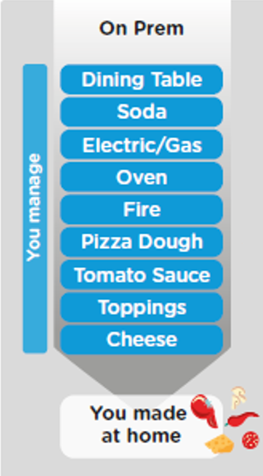
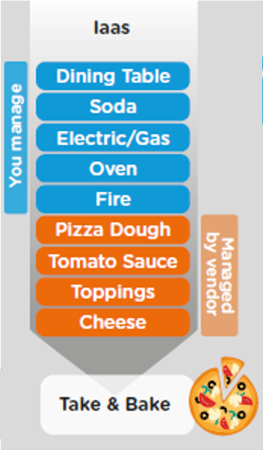
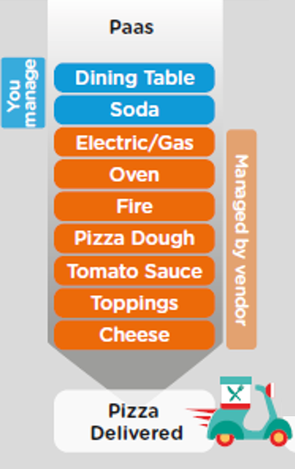
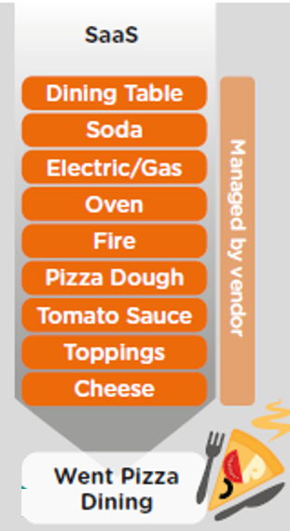
On-premise v/s Cloud Systems

Slide 6
Types of offerings in Cloud
Application
Application As a Service
Customer Managed
Customer Managed
Customer Managed
SAP Managed
Data
Runtime
Platform as a Service
SAP/Partner Managed
Middleware
Database
OS
Virtualization
Infrastructure as a Service
SAP/Partner Managed
Servers
Storage
Networking

Slide 7




What is SAP CLOUD FOUNDRY?
Application
Application
Data
Data
Runtime
Platform as a Service
Managed by SAP implementing open source CF
Middleware
Fully ready landscape with reusable services
Scalability
Elasticity
Low TCO
Database
OS
Managed by Infrastructure
providers
Data Centers
Service Portfolio
Virtualization
Infrastructure as a Service
Servers
Storage
Networking

Slide 8
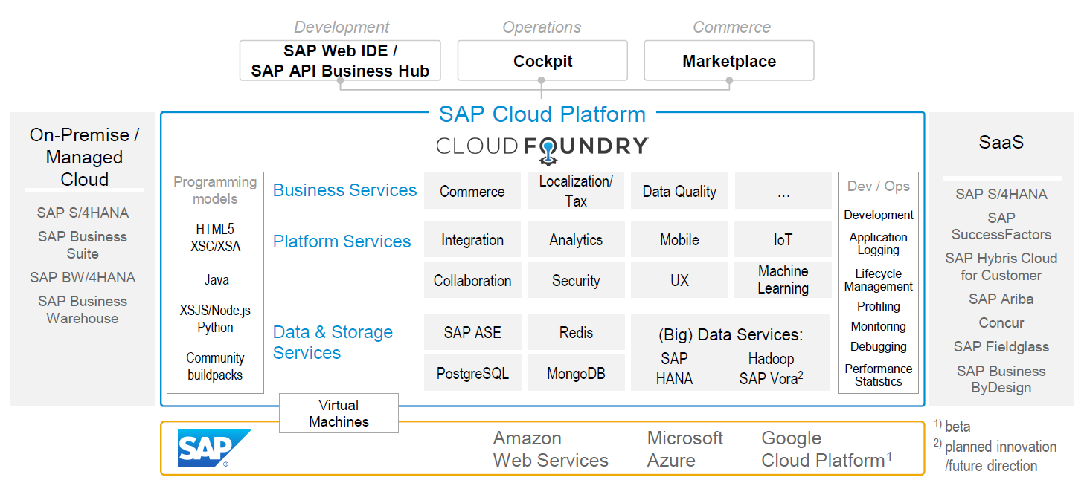
SAP Cloud Foundry Architecture
SAP Business Application Studio

Slide 9





Why Cloud Foundry?
1
Support full development lifecycle
Build Application & Services
Development
Continuous Delivery (CD) = Code ➔ Push ➔ Test ➔ Build
Continuous Integration (CI) = Dev ➔ Quality ➔ Production
Up and Down
Deployment
Testing
Monitor and Upgrade

Slide 10

Self healing
2
Self healing container management system
Cell
Garden = execution
Containers
A

Slide 11
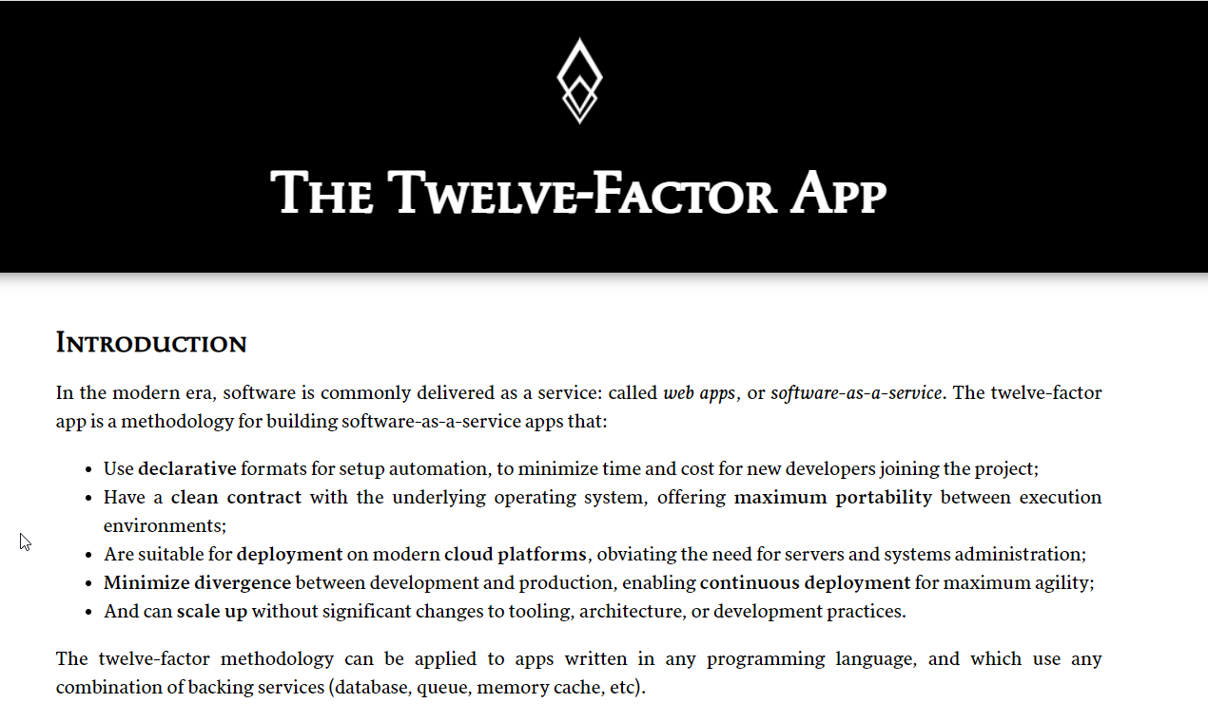

12F – App Support
3
Twelve-Factor App
It is a strategy to build software-as-a-service
https://12factor.net/
A

Slide 12
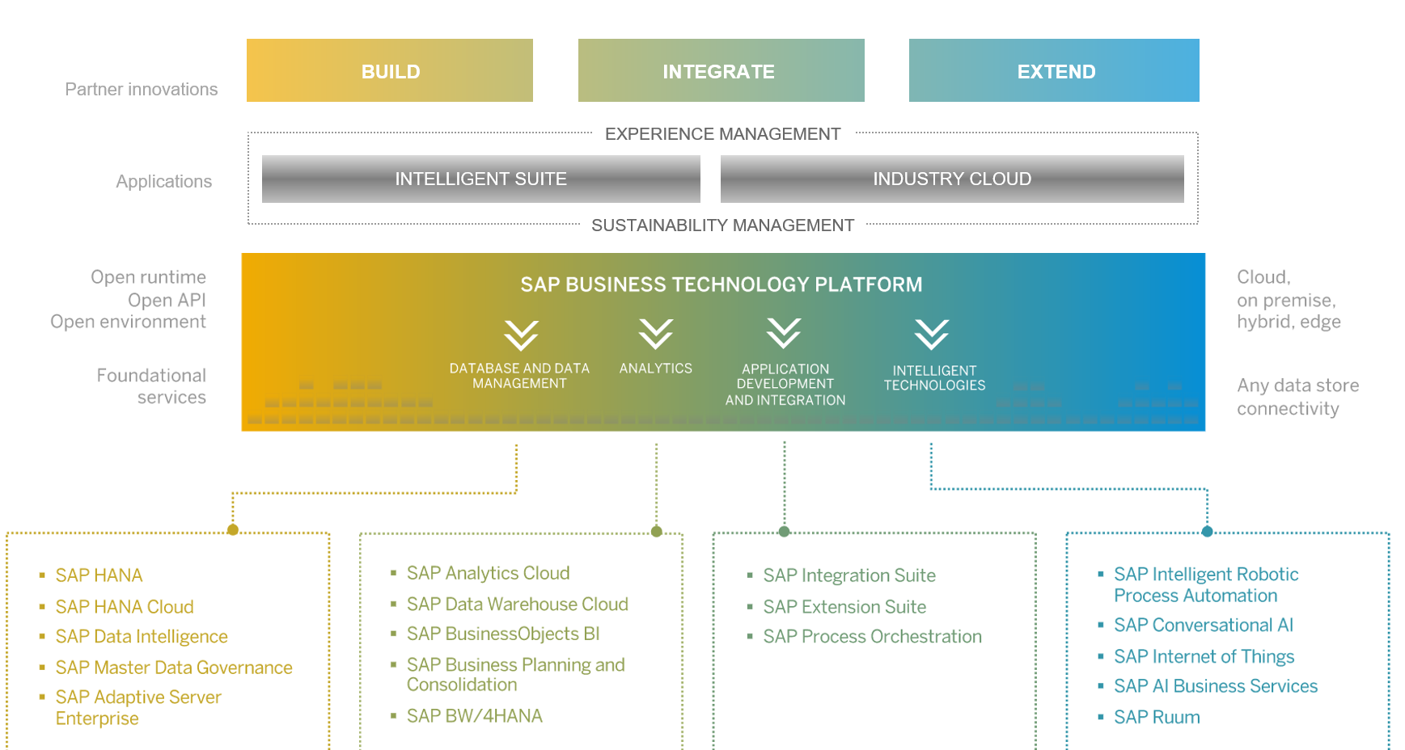
SAP BTP Architecture

Slide 13
BTP
Cockpit

Slide 14
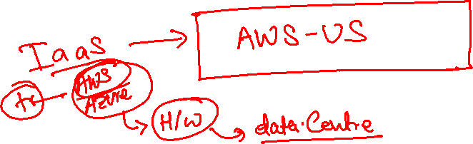
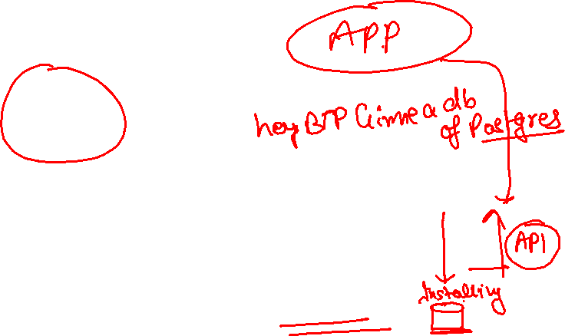
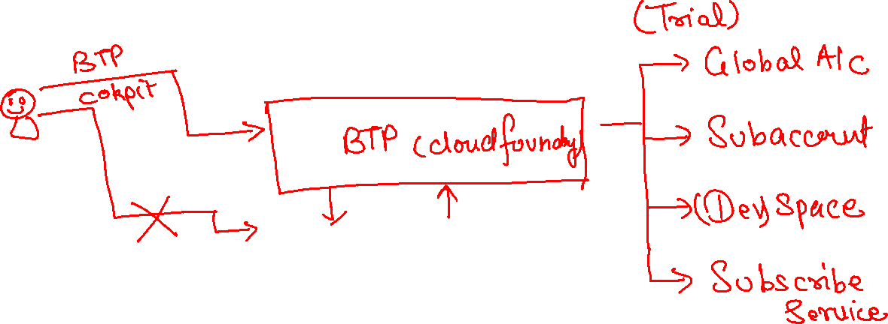

Slide 15
Org Structure BTP CF
Directories
Additional grouping of subaccount to manage policies easily
Global Account
(Representation of a customer – used for billing purpose)
e.g. IBM, EY, Nvidia
Entitlements – Services which this customer opted for
5 – HANA
100 – CF Runtime
Sub Account
Per Region, Datacenter, IaaS
(Organization by the customer, how they want to split their services and development teams)
S1 – EU (2), S2 – SG, S3 – US(3)
Space
(It is the compute unit in which we actually deploy and run our application – it constructs our landscape for development)
DEV | QLT | PROD
Assigned with Quota
Sub Account
Per Region, Datacenter, IaaS
(Organization by the customer, how they want to split their services and development teams)
S1 – EU (2), S2 – SG, S3 – US(3)
Sub Account
Per Region, Datacenter, IaaS
(Organization by the customer, how they want to split their services and development teams)
S1 – EU (2), S2 – SG, S3 – US(3)
1..*
1..*
Here we assign entitlements which we got from global account to sub accounts to organize what is really needed at each sub account level
1..*
Apps
Apps
Apps

Slide 16
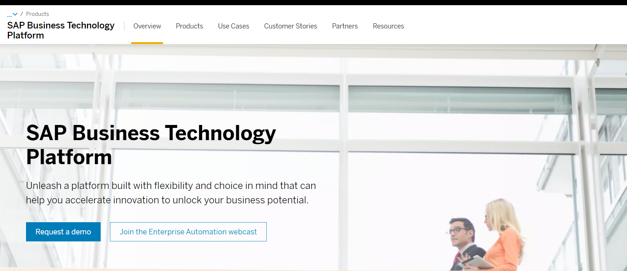
Setting up SAP BTP Account
Notes:
https://account.hanatrial.ondemand.com/trial/#/home/trial

Slide 17
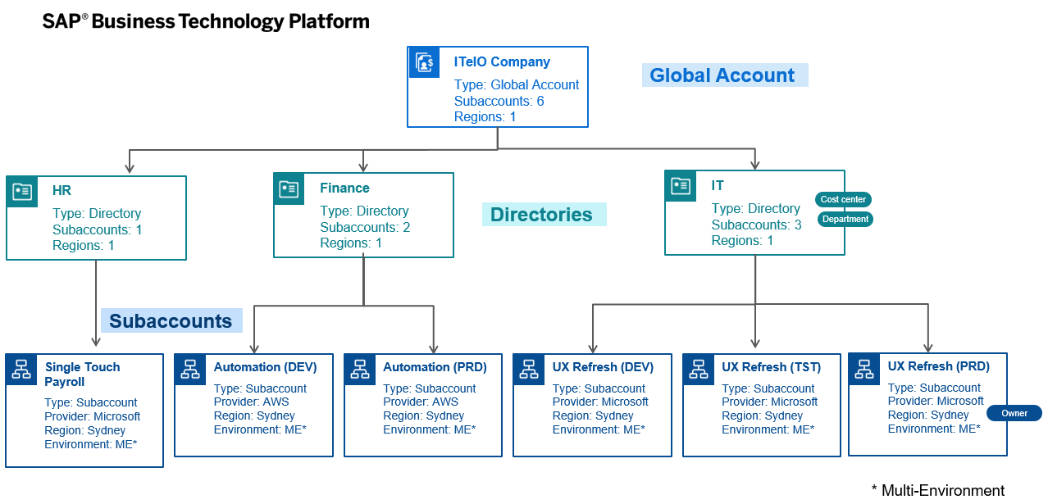
BTP Account Structure
space
space
space
space
space
space
space
space
space
space
space
space
space
Notes:
Directories allow you to group related subaccounts and create a hierarchy. With the recent update, you can have upto 5 levels of nested directories. Directories are entities which have been introduced with Feature Set B. So why would one need to use them:
Enables you to group subaccounts based on different department, Lines-of-Business, Geography, Subsidiaries etc. For example, there could be a department that has funding and want to have more control on the application or interface deployed on SAP BTP subaccount, this structure would help in providing the relevant access to the department staff
Filter based on custom properties/tags. You can create custom properties against each of the directory to search for all the relevant entities. The subaccounts under a directory inherit these custom properties and tags.
Monitor usage & cost at directory level. For example, each department will have full visibility of the usage and cost associated with their apps. This can help in 3rd party billing as well as cost chargebacks.
Allocate Service entitlement and quotas. You can allocate quota for services to the directory from the global account quota for distribution to the directory’s subaccounts.
Similar to the Global account, you can also add users at directory level to manage directory entitlements (Directory Admin, Directory Viewer)
Subaccounts are the lowest entities in the hierarchy. Its at the subaccount level, where you will be deploying your apps, databases and interfaces. Subaccounts are regions specific – meaning you can decide in which country you want to setup your subaccount environment. All the service entitlement & quotas which have been purchased and allocated via the Global Account/Directories will be consumed within these subaccounts. You also have an option to add additional custom properties/tag at the subaccount level to make it easy to search and report on them. As a subaccount administrator, you will be able to add your developers/admins to the subaccount to support with the required tasks.

Slide 18
Environments, Subs, and services
Environments
Environments constitute the actual platform-as-a-service offering of SAP BTP that allows for the development and administration of business applications. Environments are anchored in SAP BTP on subaccount level.
SAP BTP offers three environments: ABAP, Cloud Foundry and Kyma. Some existing customers still have Neo, but this is no longer offered.
Subscription based services
You will also see these ones called software as a service (SaaS), or multitenant applications. The experience here is that you subscribe to the service, and in return you receive a URL, from which you can access that service. Opening the URL brings you to a web application from which you can leverage the service. This is how other SaaS like SuccessFactors or S/4HANA Cloud work as well. They are also enabled at a subaccount level, and are independent of the environments. You don’t need to have Cloud Foundry enabled to subscribe to SAP Launchpad Service, for example.
Examples include Launchpad, SAP Business Application Studio, Cloud Integration, Process Automation…
Instance based services
These are the purest services. They provide a specific functionality, like databases, connectivity, authentication…. You connect your application to them to leverage that functionality. These services don’t provide a UI to manage them. Instead, they rely on API to connect to applications and other services and provide their services. They are provisioned inside an environment, so they are environment specific. Each environment has its own organization (for users and applications): In Cloud Foundry, instances are created inside a space. For Kyma, instances are created inside a namespace.

Slide 19














































Slide 20
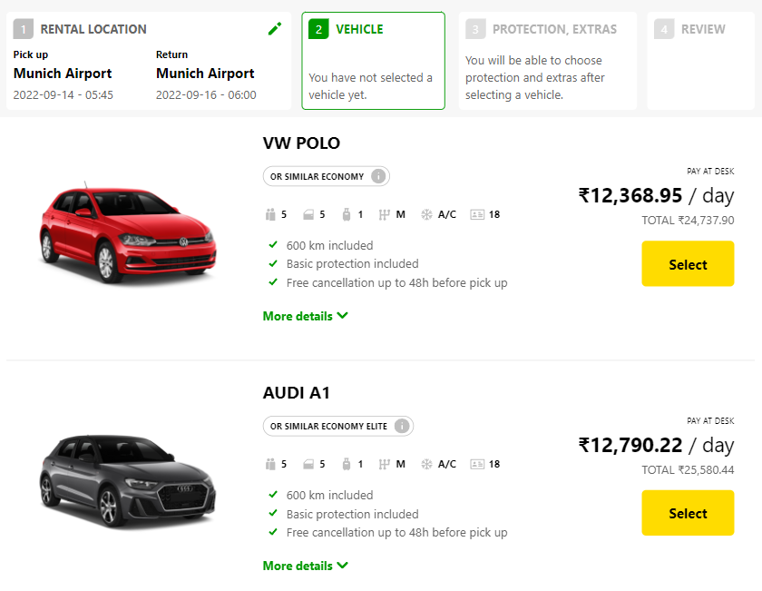
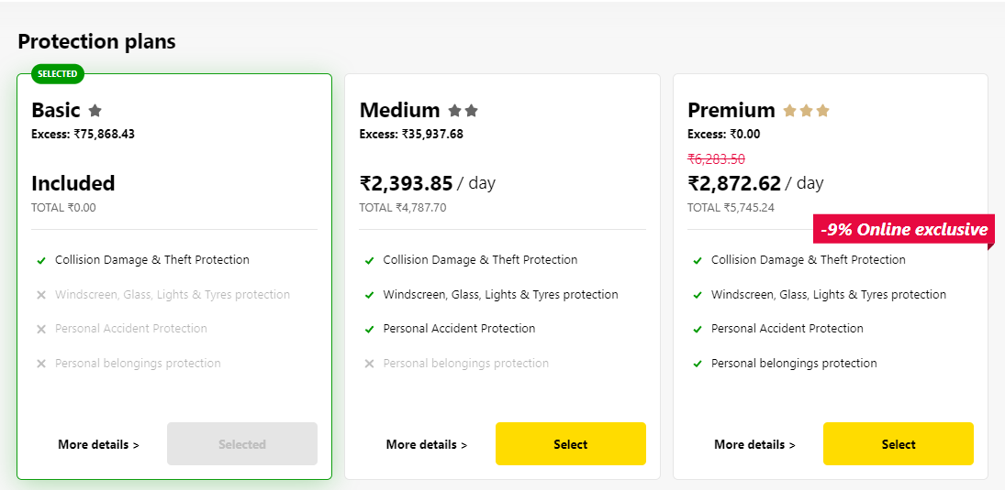
Backing Services in BTP
Each service has one or more service plans available. A service plan is the representation of the costs and benefits for a given variant of a particular service. For instance, a database may be configured with various "T-shirt sizes", each of which is a different service plan.
Choose Your service
Backing Service
Select Plan
Service Plan

Slide 21


Service instance
Car key to use Car
Service Key to Consume Service instance
Actual Car
Service Instance

Slide 22
Service Catalog & Entitlements
The SAP Discovery Center is a relatively new site hosted by SAP for developers and architects to find the services hosted by sap in SAP BTP and their respective service plans available.
It will also help technical team to identify the data center availability and cost associated with each service.
https://discovery-center.cloud.sap/#/serviceCatalog
Entitlements are the heart of all subaccounts in SAP BTP. They define which service and runtime artifacts you are able to use. When you purchase an enterprise account, you’re entitled to use a specific set of resources, such as the amount of memory that can be allocated to your applications.
An entitlement is your right to provision and consume a resource. In other words, entitlements are the service plans that you're entitled to use.
A quota represents the numeric quantity that defines the maximum allowed consumption of a resource. In other words, how much of a service plan you're entitled to use.
Entitlements and quotas are purchased and managed at global account level, from where they’re distributed to subaccounts, which consume them.
When you remove quotas or entitlements from a subaccount, they become available again at global account level and can be assigned to other subaccounts.

Slide 23
Quota Plans
In the Cloud Foundry environment, you can further distribute the quotas that are allocated to a subaccount. This is done by creating space quota plans and assigning them to the spaces.
Space quota plans are optional and are used to limit how much each space can use, not to enable. If you don't create any space quota plans, all spaces in a subaccount using the Cloud Foundry environment have access to all entitlements and quotas in that subaccount. This means that one space could use up all the quota in a subaccount.
If you want to prevent that from happening and set a limit to how much each space can use from the total quota available in the subaccount, you can use quota plans and assign them to spaces.

Slide 24
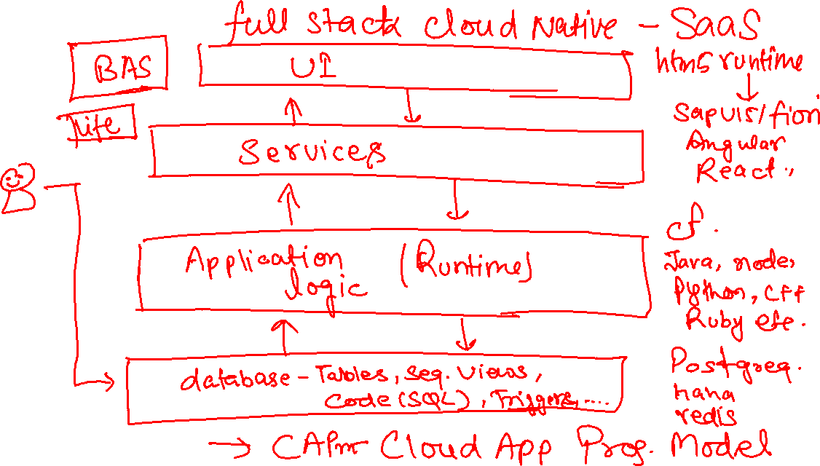
BTP Use Cases – Build New Applications

Slide 25
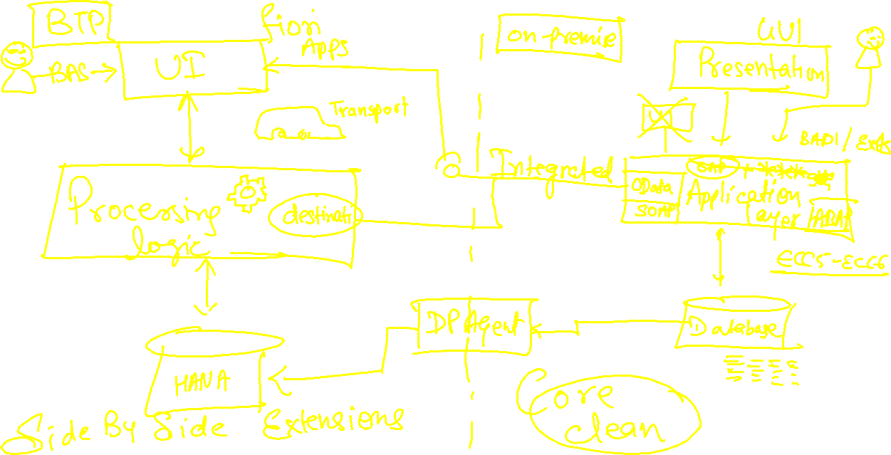
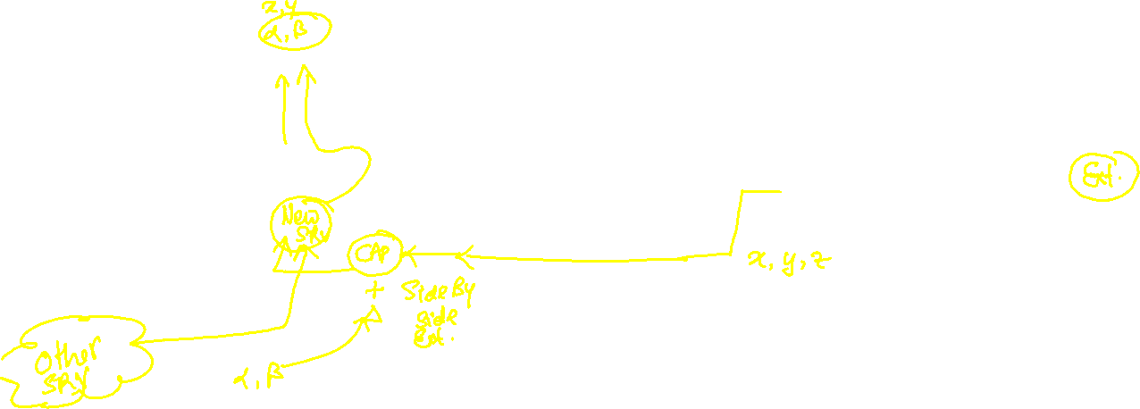
BTP Use Cases – Extend Existing Applications

Slide 26
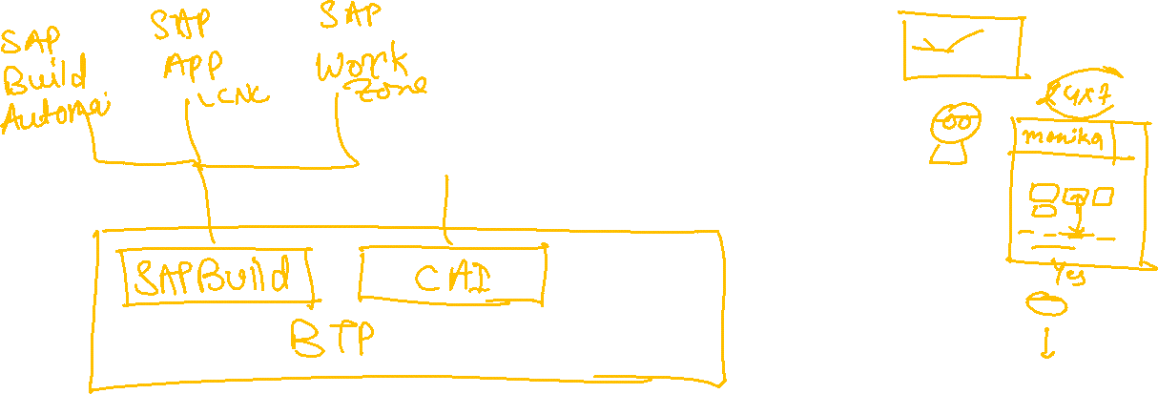
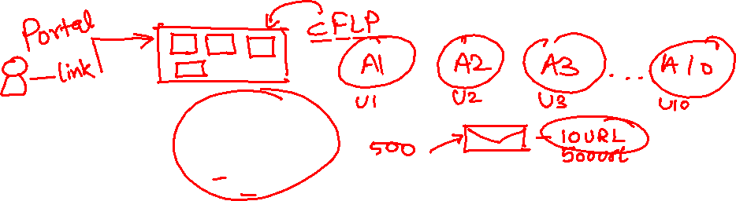
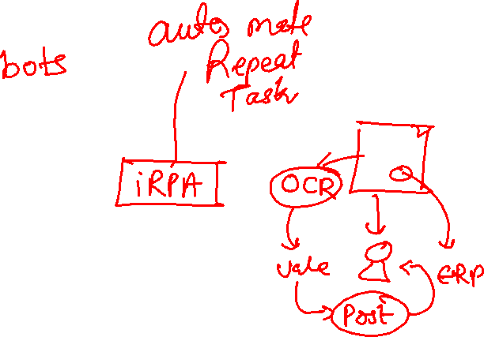
BTP Use Cases – Use intelligent Technologies

Slide 27
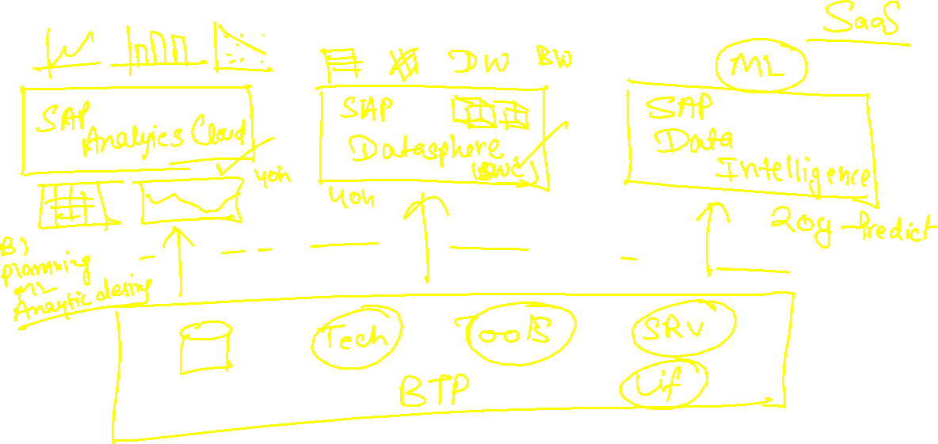
BTP Use Cases – SAP Owned Solutions

Slide 28
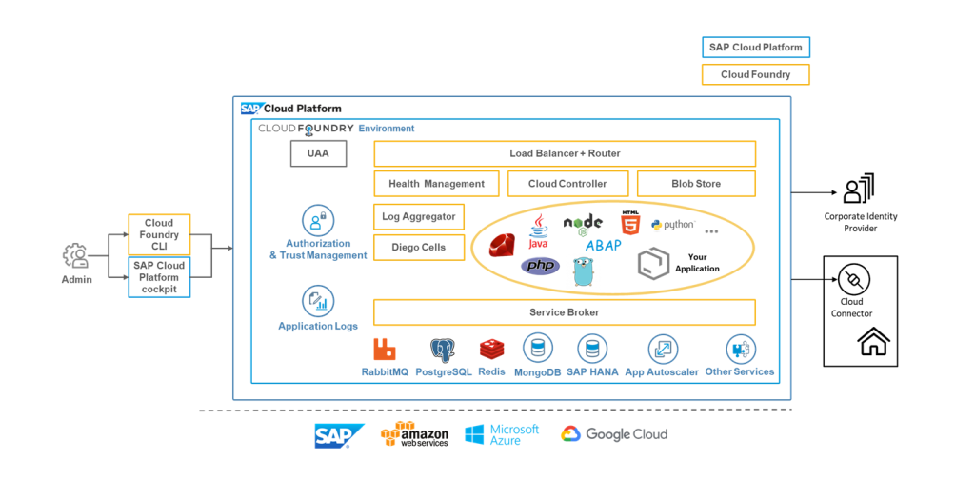
Cloud Foundry Environment

Slide 29














Tools to Setup
Git Setup - https://git-scm.com/downloads
CF CLI (Command Line Interface) Tool – allows to communicate/connect to CF
https://github.com/cloudfoundry/cli/wiki/V6-CLI-Installation-Guide
3. Microsoft VS Code - https://code.visualstudio.com/download

Slide 30

Create First Hello World App and Deploy
https://github.com/soyuztechnologies/BTP_Architect_Training/blob/master/Day%201/helloworld.zip

Slide 31
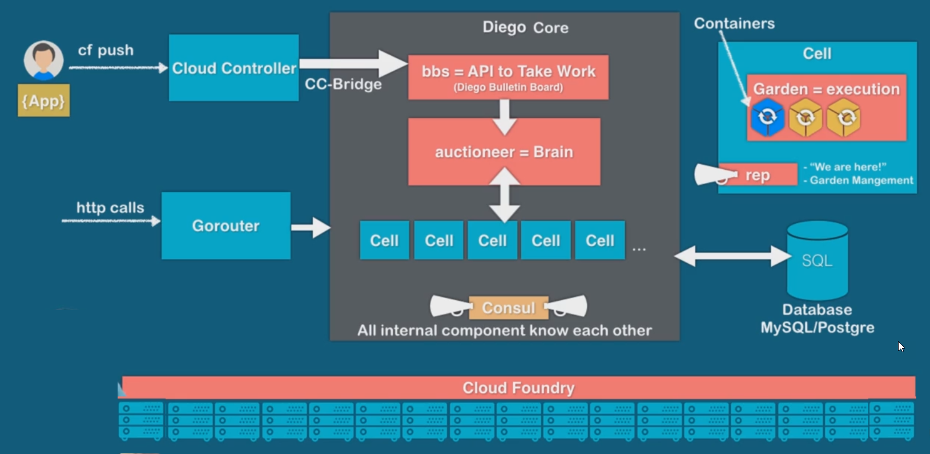
Under the hood

Slide 32

What We Did
Let’s Summarize

Slide 33

www.anubhavtrainings.com
Thank You
End of Day 1

Slide 34



We’re committed to empower you to be
#FutureReady
through powerful training solutions.
We build the workforce of the future.
250+
Corporate Clients
30,000+
Learners Trained
25000+
Learners Placed
FREE WEBINARS
Sign up for free webinars with industry experts every fortnight!
Enroll Now!
Contact us today!
https://anubhavtrainings.com

